Slide 1
Recruiter AI: An Advanced Real-Time Job Recommendation System and Resume Analyzer
B. Leela Prasad (21345A0509)
K. Nikhil Kumar (20341A0598)
L. Kiran Chandra (20341A05A8)
N. S.S.K. Dil (20341A05C9)
G. Vamsi Krishna (20341A0566)
Under the Guidance of
Dr. K. Srividya
ASSOCIATE PROFESSOR
Dept of AIML
Gmrit, Rajam

Slide 2
ABSTRACT
The increasing complexity and abundance of information in resumes has created confusion and challenges for both candidates and recruiters. An effective resume screening is crucial for students looking for job opportunities as they can demonstrate their skills and qualifications to potential employers. This study focuses on implementing a resume screening and job recommendation system using a domain adaptation approach based on a Graph neural network and Natural language processing. The goal is to extract latent features from job posts and classify resumes using GNN. The domain adaptation technique involves comparing the semantic similarity between job posts and resume contents to ensure accurate resume classification. This semantic similarity comparison plays a vital role in the domain adaptation process. By evaluating the relevance and alignment of information presented in both domains, the system can determine the suitability of a resume for a specific job post, thereby improving the accuracy of the screening process. In addition to that Glove method make accurate of understanding of the context of transforming of text to numerical, the system evaluates the resume score based on the job description and recommends the latest jobs based on the content of the resume. In conclusion, this study demonstrates the effectiveness of graphical neural network-based domain adaptation method can make more than 90% accurateness in resume screening and job recommendations.
Keywords: GNN, Self-Attention Networks, Glove, Domain Adaption, Cosine Similarity, and Resume Analyzer.

Slide 3
INTRODUCTION
In today's fiercely competitive job market, where the abundance and complexity of resumes and job postings pose significant challenges, a critical mismatch often arises between job seekers and recruiters. Conventional resume screening methods, overwhelmed by the sheer volume of applications, often fail to accurately assess the alignment of candidate qualifications with job requirements, resulting in missed opportunities. To tackle these pressing challenges head-on, this project introduces an innovative Resume Screening and Job Recommendation System that leverages cutting-edge technologies, including Graph Neural Networks (GNN) and Natural Language Processing (NLP). The project's primary objective is to extract latent features from job descriptions and classify resumes using GNN, while employing domain adaptation techniques to measure the semantic similarity between job descriptions and resume content. This semantic alignment process, integral to domain adaptation, significantly enhances the accuracy of resume classification. The system further incorporates the GloVe method to transform text into numerical data, facilitating a profound understanding of context. By evaluating resume scores based on job descriptions and recommending job openings based on resume content, this study demonstrates that the GNN-based domain adaptation method consistently achieves an accuracy rate exceeding 90% in resume screening and job recommendations.

Slide 4
This revolutionary approach represents a pivotal shift in the job matching process, offering a level of precision and efficiency previously unattainable. The project is thoughtfully structured into four interconnected modules, each serving a specific purpose. Module 1 stands as the cornerstone, categorizing resumes into job categories through a robust architecture and the aid of essential helper functions. Module 2 takes the critical role of assessing the similarity between resumes and job descriptions, quantifying alignment through meticulous preprocessing and scoring mechanisms. Module 3 assumes the task of recommending relevant job openings based on the qualifications of the candidates, ensuring a personalized and tailored experience for job seekers. Module 4 adds a dynamic dimension to the project, collecting real-time job data from a diverse array of sources, thereby guaranteeing access to the very latest listings in the ever-evolving job landscape.
This approach to the job market aims to bridge the gap between job seekers and recruiters, offering a precise and efficient matching process that benefits both parties in the highly competitive job market. By harnessing the power of GNN, NLP, and advanced adaptation techniques, this project aspires to revolutionize the way candidates are connected with job opportunities, ultimately shaping a future where missed opportunities are minimized, and the perfect job match becomes the norm. In an era of constant change and innovation, this Resume Screening and Job Recommendation System represents a beacon of efficiency and accuracy in an otherwise complex and challenging landscape.

Slide 5
LITERATURE SURVEY
BASE PAPER :
Chung, Y. C., & Kuo, R. J. (2023). A domain adaptation approach for resume classification using graph attention networks and natural language processing. Knowledge-Based Systems, 266, 110364.
The aim of the paper is to propose a domain adaptation approach based on a graph neural network for automatic resume classification in database systems. The proposed method was tested in an actual recruitment database and achieved a highly accurate result using MGAT.
The major limitations of this proposed method to enhance the model's performance, such as studying the autocorrelation of occupational groups and classifying resumes into proper categories
The proposed approach in the paper has several advantages like the proposed approach does not require labeled resume data for training the model.
The results showed that the proposed approach achieved a high accuracy of 81%.
.
The resumes need to be classified into the proper categories, and the downstream tasks, such as resume recommendation, can be further developed.

Slide 6
Reference 1
Spoorthi, M., Kuppala, M., Karpe, V. S., & Dharavath, D. (2023, March). Automated Resume Classification System Using Ensemble Learning. In 2023 9th International Conference on Advanced Computing and Communication Systems (ICACCS) (Vol. 1, pp. 1782-1785). IEEE.
This paper is to propose an automated resume classification system using ensemble deep learning models to classify resumes based on the skill set mentioned in the resume.
The accuracy of the system may depend on the quality of the data used to train the model.
The accuracy of the system may depend on the quality of the data used to train the model. If the training data is biased or incomplete, the system may not perform well.
The accuracy of the system heavily depends on the quality and completeness of the skill set mentioned in the resume. If the candidate does not mention all the relevant skills, the system may not be able to classify the resume accurately.
The Proposed ensemble learning model archives high accuracy in resume classification with 90.3% training accuracy and 88% testing accuracy .

Slide 7
Reference 2
Gu, Y., Wang, Y., Zhang, H. R., Wu, J., & Gu, X. (2023). Enhancing Text Classification by Graph Neural Networks With Multi-Granular Topic-Aware Graph. IEEE Access, 11, 20169-20183.
The objective of the paper is to propose a novel text classification method based on Graph Neural Networks (GNNs) from a multi-granular topic-aware perspective, referred to as Text-MGNN.
The effectiveness of the proposed method may depend on the specific characteristics of the datasets used in the experiments. Additionally, the paper does not explore the scalability of the proposed method to larger datasets.
The paper proposes a novel text classification method based on Graph Neural Networks (GNN) from a multi-granular topic-aware perspective, referred to as Text-MGNN. The introduction of topic nodes has significant advantages like Strengthening the propagation of topics, words, and documents, Enhancing class-aware representation learning and Mitigating the effect of heterophily information caused by polysemy words.
The results show that the proposed method outperforms 11 baseline methods. The proposed method achieves 97% accuracy with R8 dataset and with R52 it achives 94% accuracy.

Slide 8
Reference 3
Silva, G. L. L., Jayasinghe, T. L., Rangalla, R. H. M., Gunarathna, W. K. L., & Tissera, W. (2022, December). An Automated System for Employee Recruitment Management. In 2022 4th International Conference on Advancements in Computing (ICAC) (pp. 346-351). IEEE.
The aim of the paper is to develop an automated system for employee recruitment management that can save time and money for employers and provide a platform for job seekers to identify their skills and generate resumes.
The effectiveness of the system may depend on the quality of the data used to train the machine learning algorithms and the accuracy of the web scraping technology.
The automated system for employee recruitment management proposed in the paper has several advantages like Saves time and money for employers by automating processes such as skill matching, shortlisting of resumes, and scheduling interviews.
The model was trained using a JSON file, and by the end of the 27th epoch, an accuracy of 99.36% was obtained.

Slide 9
Reference 4
Ransing, R., Mohan, A., Emberi, N. B., & Mahavarkar, K. (2021, December). Screening and Ranking Resumes using Stacked Model. In 2021 5th International Conference on Electrical, Electronics, Communication, Computer Technologies and Optimization Techniques (ICEECCOT) (pp. 643-648). IEEE.
The aim of the research paper is to create an automated resume screening application using machine learning algorithms such as KNN, Linear SVC, and XGBoost.
The paper mentions that one of the limitations of the research is the size of the dataset, which restricted the authors from considering roles outside of IT.
The automated resume screening application created using machine learning algorithms can help organizations filter out relevant resumes based on job requirements, saving time and effort in the recruitment process.
The proposed method achieves 85% using XGBoost and 83% for Linear SVC and Stacked Classifier.

Slide 10
Reference 5
Tripathi, R. C. (2022, December). An Approach of Intelligent Automated Resume Analysis & Recommendations. In 2022 Fourth International Conference on Emerging Research in Electronics, Computer Science and Technology (ICERECT) (pp. 1-5). IEEE.
The aim of the paper is to propose an approach for intelligent automated resume analysis and recommendations to simplify the tedious process of fair screening and brief posting of job applications.
The paper does not explicitly mention any limitations of the proposed approach for intelligent automated resume analysis and recommendations. However, it does mention the problem of information being less accessible through client-thing relationships, and the need to remove stop words and perform stemming to simplify the screening process.
Simplifying the tedious process of fair screening and brief posting of job applications. Allowing hiring firms to save time and money by using an automated system for "Resume Grouping and Coordinating" instead of physically sorting through resumes.
The proposed approach may depend on the quality of the dataset and achieves 87% accuracy for Linear SVC classifier for resume analysis and recommendations .

Slide 11
Reference 6
Sridevi, G. M., & Suganthi, S. K. (2022). AI based suitability measurement and prediction between job description and job seeker profiles. International Journal of Information Management Data Insights, 2(2), 100109.
The aim of the paper is to develop an Artificial Intelligence (AI) based system to measure and predict a suitable candidate from an available Candidate Resume (CR) database for a specific job. The objective is to use four clusters prepared from Job Description (JD) and CR corresponding to primary skills, secondary skills, adjectives, and adverbs, and measure the Jaccard similarity between these clusters to propose a suitability measure based on the cluster parameters.
It is important to note that the effectiveness of the system may depend on the quality and relevance of the data used for training the system. Additionally, the system may not be able to capture certain nuances or subjective factors that may be important in the hiring process. It is also possible that the system may not be suitable for all types of jobs or industries. Further research and testing may be required to fully evaluate the limitations of the proposed system.
The system can be used to extract information content and qualitative descriptions from resumes and job descriptions, which can be useful for other HR processes such as performance management and talent retention.
The system achieves high accuracy in predicting candidate suitability, with a maximum average accuracy of 95.14% for the XGBoost classifier.

Slide 12
Reference 7
Wu, L., Qiu, Z., Zheng, Z., Zhu, H., & Chen, E. (2023). Exploring Large Language Model for Graph Data Understanding in Online Job Recommendations. arXiv preprint arXiv:2307.05722.
The objective of the paper is to explore the potential of Large Language Models (LLMs) in understanding behavior graphs and leveraging this understanding to enhance recommendations in online recruitment, including the promotion of out-of-distribution (OOD) application.
The proposed GLRec model and all baselines in the experimental results. The distinctive score gaps demonstrate the superiority and adaptability of the large-scale model framework that incorporates relationship understanding and extensive semantic knowledge in the job recommendation scenario.
The paper mentions some areas that need to be further optimized, such as larger scale experimental validation and finer-grained module testing.
Some of the advantages like GLRec leverages the semantic richness and massive knowledge of LLMs to analyze behavior graphs and uncover underlying patterns and relationships, which enables personalized and accurate job recommendations for individual users.
The paper evaluates the effectiveness of the proposed GLRec framework using the Area Under the Receiver Operating Characteristic (AUC) metric, which is a conventional evaluation metric for explicit recommendation. AUC curve reaches upto 90% for GLRec.

Slide 13
Reference 8
Zheng, Z., Qiu, Z., Hu, X., Wu, L., Zhu, H., & Xiong, H. (2023). Generative Job Recommendations with Large Language Model. arXiv preprint arXiv:2307.02157.
The aim of the paper is to propose a novel approach called GIRL (GeneratIve job Recommendation based on Large language models) for job recommendation systems that utilizes Large Language Models (LLMs) to generate personalized job descriptions for job seekers.
The effectiveness of the GIRL approach may depend on the quality and quantity of the data used for training the models. Additionally, the paper does not discuss the potential ethical implications of using AI-based job recommendation systems, such as the risk of perpetuating bias or discrimination.
The approach utilizes Large Language Models (LLMs) to bridge the semantic gap between CVs and JDs, which can improve the accuracy and relevance of job recommendations. The approach is more explainable than traditional "black-box" recommendation systems, as it generates job descriptions that can be easily understood by job seekers and recruiters.
The paper mentions that the performance of the GIRL approach is evaluated using two different metrics: AUC and LogLoss. These metrics are used to evaluate the effectiveness of the approach in enhancing the performance of discriminative recommendation. The paper does not provide further details on how these metrics are calculated or what specific values were obtained in the experiments.

Slide 14
Reference 9
Li, S., Li, K., & Lu, H. (2023). National Origin Discrimination in Deep-learning-powered Automated Resume Screening. arXiv preprint arXiv:2307.08624.
The aim of the research paper is to examine the potential bias in deep-learning-powered automated resume screening tools, specifically in the use of word embedding to represent resumes as low-dimensional vectors. The study focuses on the national origin bias in the word embedding-based automated resume screening and aims to develop a bias mitigation method to address the issue.
The research paper does not explicitly mention any limitations of the study. However, it is important to note that the study focuses on the national origin bias in the word embedding-based automated resume screening and may not address other types of biases that may exist in the hiring process. Additionally, the study's experiments were conducted on a specific set of candidate resumes, and the results may not be generalizable to other datasets.
The research paper does not explicitly mention any advantages of the study. However, it highlights the potential advantages of using deep learning methods, specifically word embedding, to represent resumes as low-dimensional vectors, which are used for downstream tasks like resume screening. The resulting word representations possess interesting linear substructures of the word vector space and are easy to process.
The paper discusses the development of a fairness measure to determine bias severity in the automated resume screening process. The paper also discusses the use of different values of the boundary parameter (τ) and the regularization parameter (λ) to evaluate the performance of the bias mitigation method. The best performance measure is achieved when λ = 50 and τ = 0.4.

Slide 15
Reference 10
Zhu, Y. (2022, October). A Hybrid Job Recommendation Algorithm for Intelligent Employment System Using User Profile-Based Filtering. In 2022 IEEE 2nd International Conference on Data Science and Computer Application (ICDSCA) (pp. 561-565). IEEE.
The aim of this paper is to propose a hybrid job recommendation algorithm for college employment systems that can help in finding the right candidate for a company by comparing the ability data of current employees with recent campus graduates who do not have any working experience. The proposed method considers ability similarity and demographic similarity, combined with traditional collaborative filtering, to make the prediction more precise and suitable for real-world situations.
The effectiveness of the algorithm may depend on the quality and quantity of data available for analysis. Additionally, the algorithm may not be suitable for all types of employment systems and may require customization based on specific requirements.
The algorithm can help in finding the right candidate for a company by comparing the ability data of current employees with recent campus graduates who do not have any working experience. The proposed method considers ability similarity and demographic similarity, combined with traditional collaborative filtering, to make the prediction more precise and suitable for real-world situations.
The performance metric used to evaluate the proposed hybrid job recommendation algorithm. However, the paper shows the precision of the recommendation varying with different final recommended jobs from 5 to 30. It is possible that precision is one of the performance metrics used to evaluate the algorithm.

Slide 16
Reference 11
Shaikym, A., Zhalgassova, Z., & Sadyk, U. (2023, June). Design and Evaluation of a Personalized Job Recommendation System for Computer Science Students Using Hybrid Approach. In 2023 17th International Conference on Electronics Computer and Computation (ICECCO) (pp. 1-7). IEEE.
The aim of the paper is to design and evaluate a personalized job recommendation system for computer science students using a hybrid approach. The system utilizes advanced algorithms and feature selection techniques to provide personalized job recommendations for students based on their skills, interests, and career goals. The paper also compares the performance of the system with existing job recommendation systems.
the system was evaluated using a dataset of job postings and student profiles, which may not be representative of all possible job markets and student populations. Additionally, the system's performance may be affected by factors such as data quality, feature selection, and algorithm selection. Further research and testing may be needed to fully understand the limitations and potential of the system.
The paper highlights several advantages of the personalized job recommendation system for computer science students, includes Personalization, accuracy, efficiency, and potential for practical applications are the pros of the personalized job recommendation system.
The Overall system achives precision 0.45, 0.61 recall and 0.52 F1-Score.
It does suggest future research directions, such as exploring the use of additional data sources, incorporating user feedback, and investigating the impact of different feature selection techniques on the performance of the system. These directions could potentially address any limitations or gaps in the current study and further improve the effectiveness and efficiency of personalized job recommendation systems for students.

Slide 17
Reference 12
Sharma, M., Choudhary, G., & Susan, S. (2023, January). Resume Classification using Elite Bag-of-Words Approach. In 2023 5th International Conference on Smart Systems and Inventive Technology (ICSSIT) (pp. 1409-1413). IEEE.
The aim of the paper is to propose a method for efficient classification of resumes using machine learning and natural language processing techniques. The authors introduce a text vectorization technique called Elite bag-of-words for the vectorization of resumes and compare its performance with other existing bag-of-words approaches. The paper also discusses the pre-processing steps required for text data before applying suitable machine learning models on the dataset.
It is important to note that the performance of the Elite bag-of-words approach may vary depending on the dataset and the specific job profiles being considered. Additionally, the pre-processing steps discussed in the paper may not be applicable or optimal for all types of text data.
The Elite bag-of-words approach efficiently maps resumes to their corresponding job profiles by extracting the top-ranked significant keywords in each class. The approach removes redundant and non-informative keywords or feature columns, which can affect the performance of resume classification. The approach outperforms other existing bag-of-words approaches for resume classification, as demonstrated by the experimental comparisons presented in the paper.
The proposed method achives 62.6 testing accuracy.

Slide 18
Reference 13
Petersheim, C., Lahey, J., Cherian, J., Pina, A., Alexander, G., & Hammond, T. (2022). Comparing Student and Recruiter Evaluations of Computer Science Resumes. IEEE Transactions on Education, 66(2), 130-138.
The paper aims to compare student and recruiter evaluations of computer science resumes to understand potential disparities and improve resume preparation for better recruitment outcomes.
Limited generalizability to other fields or career stages, lack of qualitative analysis for deeper insights, and potential bias in participant selection that may impact the validity of results.
Advantages of this paper include its novelty in Studying computer science resumes, practical implications for students, and a relatively large sample size.
Students were 7.4% more likely to move resumes to the next level than recruiters. Students spent 7.2 seconds less reviewing each resume on average. Each point increase in GPA improved the probability of being moved by 26.6-28.5%.
Limited sample size, potential lack of generalizability, and limited exploration of factors beyond work experience, GPA, and specific skills.

Slide 19
Reference 14
Du, Y., Luo, D., Yan, R., Liu, H., Song, Y., Zhu, H., & Zhang, J. (2023). Enhancing Job Recommendation through LLM-based Generative Adversarial Networks. arXiv preprint arXiv:2307.10747.
The objective is to enhance job recommendation systems using LLM-based Generative Adversarial Networks, exploring how this approach can improve the accuracy and effectiveness of job recommendations for users.
The limitations of fabricated generation and few-shot problems with LLMs are acknowledged but not extensively addressed in the proposed approach.
The paper demonstrates the effectiveness of using large language models (LLMs) in job recommendation systems and incorporates user interaction history for more accurate resumes.
The proposed method called LGIR With 80% accuracy consistently outperforms the baseline methods in improving job recommendation performance. Therefore, LGIR has better results compared to the other methods evaluated in this ablation study.
Gaps in this paper may include a lack of comparison with existing methods, limited discussion on potential limitations, and insufficient evaluation using diverse datasets or real-world scenarios.

Slide 20
EXISTING METHODOLOGY
The methodology presented in the base paper focuses on improving the accuracy and efficiency of resume classification and job recommendation through a well-structured series of steps. It initiates with data preprocessing and word representation, where both job posts and resumes undergo separate preprocessing. Standard text cleaning techniques are applied, including the removal of stopwords, punctuation, abnormal characters, and non-ASCII strings. To address the challenge of personal information that doesn't significantly impact resume classification but cannot be removed through standard preprocessing, a Part of Speech (POS) tagging model is introduced. This model tags tokens in resumes and retains only those tagged as 'NOUN,' 'ADJ,' 'VERB,' and 'ADV.' Additionally, abnormal and misspelled words are filtered out, resulting in a set of keywords and general text that provide differentiating characteristics. For word representation, the base paper utilizes pre-trained GloVe embeddings to convert each resume or job post into a set of features, thereby enhancing graph construction and improving the overall robustness of the model. At the core of the methodology lies the domain adaptation approach, which relies on measuring the semantic similarity between job posts and resumes. This approach amalgamates the knowledge from both datasets into a shared adjacency matrix denoted as A. This shared representation is crafted by embedding the unique words (V) into 300-dimensional word features. The adjacency matrix A becomes the cornerstone of the methodology, effectively representing the common patterns observed in the source domain.

Slide 21
Word correlations are established based on co-occurrence within a sliding window of three words, and these co-occurrence weights are harnessed as edge weights in the constructed graphs. Once the model is trained to discern keyword patterns and their correlations, it becomes capable of classifying resumes in the target domain without necessitating retraining. The Graph Multi-Headed Attention Networks Classifier assumes a pivotal role in the methodology. Each resume or job post is transformed into an undirected and weighted graph, where unique words serve as nodes. Node embeddings are initialized with word features, and edges are established based on word co-occurrence within a sliding window. A multi-headed attention algorithm is applied, encompassing various steps such as node feature transformation, attention coefficient calculation, LeakyReLU activation to emphasize positive relationships, and Softmax normalization to ensure that coefficients fall within an appropriate range. The outcome is a document embedding that effectively captures the essence of the resume or job post. Prior to generating document embeddings, average pooling and dropout functions are applied to smoothen features and retain critical information. In conclusion, this methodology thoughtfully combines meticulous data preprocessing, domain adaptation through shared representations, and advanced graph-based classification techniques. Its primary objective is to significantly enhance the accuracy of resume classification and job recommendations, thereby benefiting both job seekers and recruiters in navigating the competitive job market.

Slide 22
PROPOSED METHODOLOGY
To develop a comprehensive resume screening and job recommendation system that leverages advanced natural language processing and graph neural network techniques to enhance the efficiency and accuracy of the job matching process. This system aims to provide a tailored and data-driven approach to assist both job seekers and recruiters by predicting job categories, calculating matching scores, offering job and skill recommendations, and continuously updating job listings.
Various Modules Involved:
Predicting Category : Predict the category of a resume based on its content. The Key Components involved in this module are Data loading and preprocessing, Glove Tokenizer, Message Passing Layer, Text Level GNN Model Building and Training.
Matching Score Between Resume and Description: Compute a matching score between a given resume and a job description. The Key Components includes in this module are Text preprocessing, Named Entity Extraction, Keyword Extraction, Score Computation.
Job and Skill Recommendation System: Recommend relevant job roles and skills to candidates based on their resume content and the predicted job category.
Real-time Job Web Scraping: Continuously scrape up-to-date job listings from various websites, suitable predicted job category. The Key Components includes in this module are Web scraping techniques and data enrichment.

Slide 23
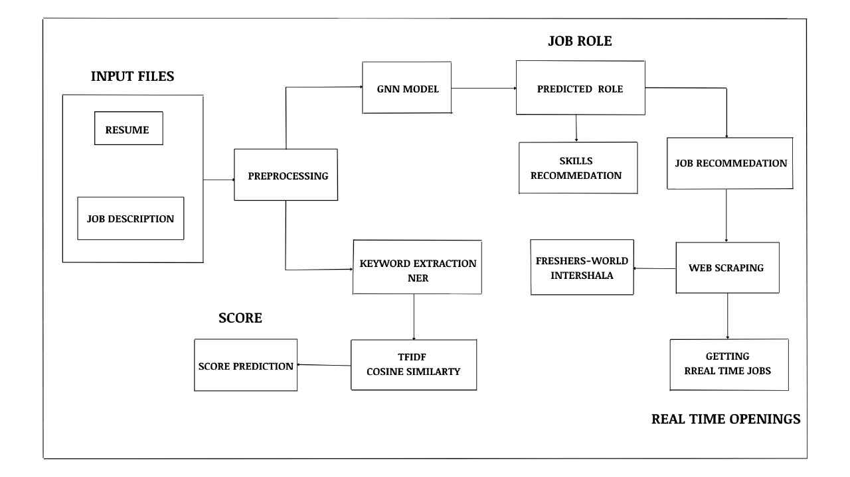
Block Diagram

Slide 24
Datasets:
Dataset 1: Resume Dataset
- used for job category prediction - includes 2 fields Category and resumes
- Shape of dataset 962 * 2
Dataset 2: Jobs On Naukri.com - used for job and Skills Recommendation System - includes fields like Job Salary, Job Experience Required, Key Skills, Role Category, Functional Area, Industry, Job Title Category and resumes
- Shape of dataset 27010 * 7

Slide 25
Module – 1 : Category Prediction
The objective of this module is to predict the category or domain of a resume based on its content. This module plays a crucial role in automating the initial phase of resume screening, allowing companies to efficiently categorize resumes for job openings.
Data Loading and Preprocessing:
Training and test data are loaded from files, typically containing labelled examples of resumes and their corresponding categories . A vocabulary is constructed based on the training data, which includes all unique words in the resumes. Public edge masks are created to represent common word co-occurrences in the text data, which can be useful for capturing semantic relationships.
Glove Tokenizer :
This component is responsible for tokenizing and embedding the text data. It loads pre-trained GloVe word vectors, which provide pre-trained word representations. It creates token-to-index (stoi) and index-to-token (itos) dictionaries, which map words to indices and vice versa . An embedding matrix is built using GloVe vectors, which serves as the basis for representing words in the

Slide 26
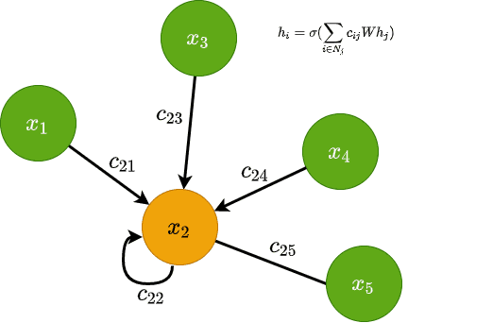
model and the Glove Tokenizer provides methods for encoding (converting text to numerical data), decoding (retrieving text from numerical data), and embedding (representing text as vectors) the text data.
MessagePassing Layer:
This layer is an integral part of the Graph Neural Network (GNN) model. It operates on node embeddings and edge weights, facilitating message-passing among nodes in the graph. This process helps capture semantic relationships between words in the resumes. The layer includes a linear transformation followed by ReLU activation and softmax to compute node representations. An information rate parameter controls the influence of neighbouring nodes during message-passing.

Slide 27
TextLevelGNNDataset:
This PyTorch dataset class is responsible for organizing and accessing the data for training, validation, and testing. It takes node sets (text data), neighbour sets (graph connections), public edge masks, and labels as input. The class provides methods for retrieving data samples and computing the dataset's length, essential for data iteration during training.
TextLevelGNN Model:
The TextLevelGNN Model is the core of the module for text classification. It utilizes pre-trained word embeddings from GloVe. The model takes node sets (text data), neighbour sets (graph connections), and public edge masks as input. The model performs message-passing to compute node embeddings, which capture the context and semantics of words in the resumes. The final output is generated using a linear layer followed by softmax for text classification, predicting the category of the resume.This utility function creates neighbour sets in the graph, facilitating the establishment of connections between words in the resumes. Pad custom sequence and padding tensor are used for padding sequences to have the same length, a common data preparation step when working with text data.

Slide 28
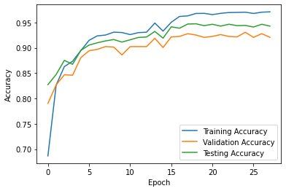
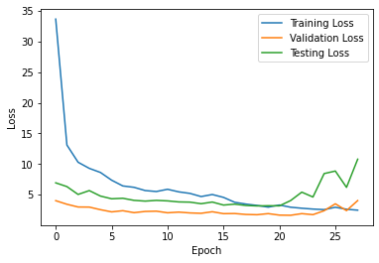
Performance Metric : Accuracy :
Training Accuracy | 0.97
Validation Accuracy | 0.92
Testing Accuracy | 0.94

Slide 29
Module – 2 : Matching Score Between Resume and Description
The objective is to compute a matching score between a given resume and a job description. This matching score indicates the similarity or relevance of the resume to the job description, helping job seekers and employers make informed decisions.
Text Preprocessing:
The process begins with text preprocessing to ensure that both the resume and job description are in a suitable format for comparison. The Preprocessing class contains several methods for text preprocessing, including extracts text content from a resume PDF file. Tokenizes, removes stop words, and lemmatizes the text. POS Tagging and Filters tokens based on parts of speech (Nouns and Verbs and identifying named entities in the text. Extracts relevant keywords from the text.
Data Preparation:
The score process function takes the paths of the resume and job description files as inputs. It uses the Preprocessing class to extract and preprocess text from both files, resulting in clean and structured text data. The pre-processed text data is then combined for further processing.

Slide 30
Vectorization:
To compare the similarity between the resume and job description, the text data needs to be converted into a numerical format. The Count Vectorizer from scikit-learn is used to transform the text data into a document-term matrix. This matrix represents the frequency of words in each document (resume and job description).The resulting matrix is used to calculate the cosine similarity between the two documents.
Cosine Similarity Calculation:
Cosine similarity is a metric used to measure the cosine of the angle between two non-zero vectors in a multi-dimensional space. In this case, the vectors represent the term frequency vectors of the resume and job description. The cosine similarity function computes the cosine similarity between these vectors, resulting in a similarity score ranging from -1 (completely dissimilar) to 1 (completely similar). The similarity score is multiplied by 100 and rounded to two decimal places to provide a percentage-based matching score. This matching score reflects the degree of similarity between the resume and job description, indicating how well the candidate's qualifications match the job requirements.

Slide 31
Module – 3 : Job and Skill Recommendation System
The objective is to build a Job and Skill Recommendation System that takes as input the category of a job and provides recommendations for relevant job listings and associated key skills. This recommendation system helps job seekers find suitable job opportunities based on their preferred job category, while also suggesting relevant skills for their career development. Methodology Steps for Recommendation System. The recommendation system begins by taking the input category of the job from the user or job seeker. This category represents the domain or type of job they are interested in.
Data Preparation:
The recommendation system relies on a dataset of job listings and their associated key skills. The dataset should include information such as job titles, key skills, and job categories.
TF-IDF Vectorization:
To analyse the relevance of job listings and key skills to the input category, TF-IDF (Term Frequency-Inverse Document Frequency) vectorization is applied. The TF-IDF Vectorizer is used to convert the text data (key skills) into numerical vectors. The vectorization process calculates the importance of each term (key skill) in relation to the entire dataset of job listings.

Slide 32
Cosine Similarity Calculation:
Cosine similarity is employed to measure the similarity between the TF-IDF vectors of the input job category and each job listing's key skills. Cosine similarity calculates the cosine of the angle between two vectors, with higher values indicating greater similarity.
Recommendation System:
The recommendation system computes the cosine similarity between the input category and all job listings' key skills. It then ranks the job listings based on their similarity scores in descending order, identifying the most relevant job listings. The top-n job listings (where n is a predefined number) are recommended to the user as potential job opportunities. Skill and job recommendations, the system also identifies relevant key skills associated with the recommended job listings. These skills can be important for job seekers to acquire or highlight in their resumes when applying for the recommended positions. The recommendation system presents the user with a list of recommended job listings and associated key skills. The user can then explore these recommendations and take appropriate actions, such as applying for jobs or improving their skills.

Slide 33
Hybrid Recommendation System: To enhance the recommendation system further, a hybrid approach can be employed. Hybrid recommendation systems combine multiple recommendation techniques, such as content-based and collaborative filtering, to provide more personalized and accurate recommendations. In a hybrid system, user preferences, behaviour, and interactions with the platform can also be considered to fine-tune recommendations. Job seekers can use the recommendation system to discover relevant job opportunities and understand the key skills required in their chosen field. Employers can utilize the system to suggest job titles and key skills to include in job listings, improving their chances of attracting suitable candidates.

Slide 34
Module – 4: Real Time Jobs – Web Scraping
Real-Time Jobs – Web Scraping, is dedicated to the objective of extracting up-to-the-minute job listings from specific websites, Internshala and Fresherworld. The methodology consists of six key steps for each website. First, it involves retrieving data by sending GET requests to the respective job URLs. Next, it parses the HTML content of the web pages using BeautifulSoup for structured navigation. Third, it locates and extracts job listings by identifying specific HTML elements. Fourth, it extracts essential job details such as job titles, company names, locations, start dates, and application links. Fifth, it ensures data completeness by checking for the presence of all necessary details before processing. Finally, it formats the extracted data into dictionaries for each job listing and compiles them into a list.
Steps :
- Data Retrieval
- HTML Parsing
- Locate Job Listings
- Data Extraction
- Data Formatting

Slide 35
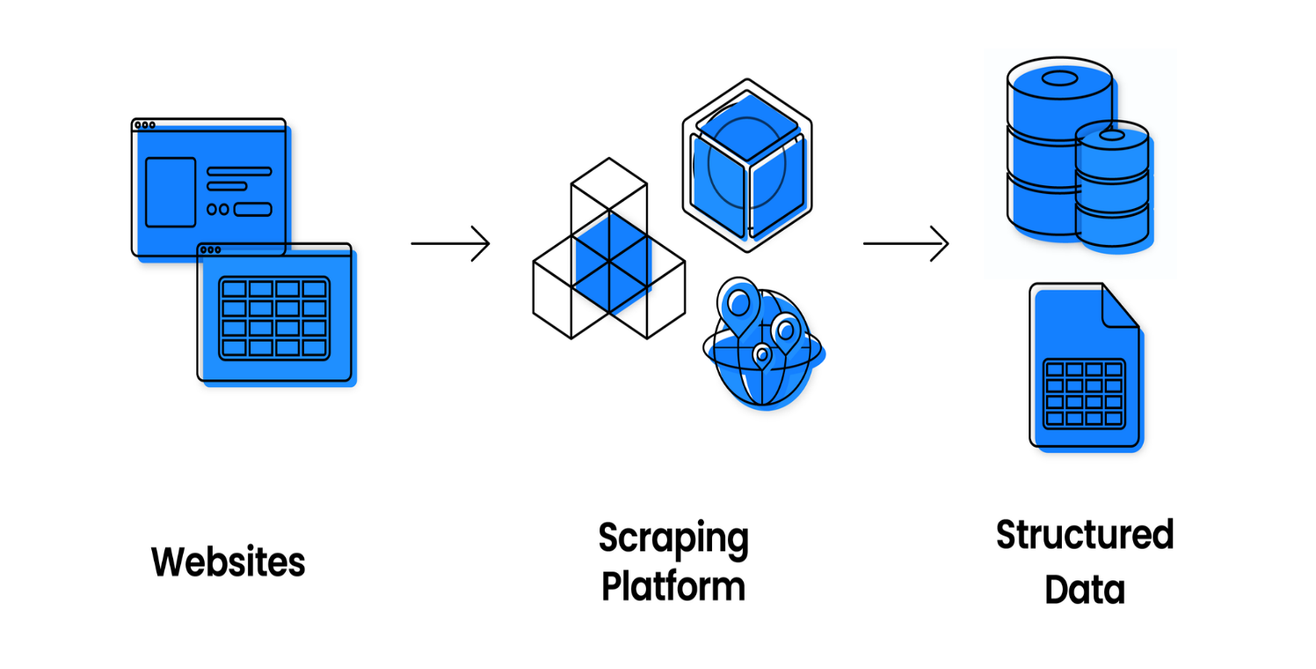

Slide 36
REFERENCES
[1] Chung, Y. C., & Kuo, R. J. (2023). A domain adaptation approach for resume classification using graph attention networks and natural language processing. Knowledge-Based Systems, 266, 110364.
[2] Harsha, T. M., Moukthika, G. S., Sai, D. S., Pravallika, M. N. R., Anamalamudi, S., & Enduri, M. (2022, April). Automated resume screener using natural language processing (NLP). In 2022 6th international conference on trends in electronics and informatics (ICOEI) (pp. 1772-1777). IEEE
[3] Petersheim, C., Lahey, J., Cherian, J., Pina, A., Alexander, G., & Hammond, T. (2022). Comparing Student and Recruiter Evaluations of Computer Science Resumes. IEEE Transactions on Education, 66(2), 130-138
[4] Sridevi, G. M., & Suganthi, S. K. (2022). AI based suitability measurement and prediction between job description and job seeker profiles. International Journal of Information Management Data Insights, 2(2), 100109.
[5] Zheng, Z., Qiu, Z., Hu, X., Wu, L., Zhu, H., & Xiong, H. (2023). Generative Job Recommendations with Large Language Model. arXiv preprint arXiv:2307.02157.
[6] Wosiak, A. (2021). Automated extraction of information from Polish resume documents in the IT recruitment process. Procedia Computer Science, 192, 2432-2439.

